Slide 1
AGENTIC AI for Personalized Course Pathways
CAPSTONE PROJECT
Presented By:
Student name : Pearl D’Souza
College Name & Department : CSIBER,Kolhapur MCA

Slide 2
OUTLINE
Problem Statement
Technology used
Wow factor
End users
Result
Conclusion
Git-hub Link
Future scope
IBM Certifications

Slide 3
PROBLEM STATEMENT
Students often struggle to identify the right learning path that aligns with their interests and long-term goals due to the overwhelming number of online courses and a lack of personalized guidance.
Proposed Solution: CareerHelper aims to solve this by acting as an Agentic AI coach that interacts with students, understands their interests (like Frontend Development, Cybersecurity, UI/UX Design, etc.), assesses their current skill level, and dynamically builds a personalized course roadmap that adapts over time based on progress and preferences.

Slide 4
TECHNOLOGY USED
IBM cloud lite services
Natural Language Processing (NLP)
Retrieval Augmented Generation (RAG)
IBM Granite model

Slide 5
IBM CLOUD SERVICES USED
IBM Cloud Watsonx AI Studio
IBM Cloud Watsonx AI runtime
IBM Cloud Agent Lab
IBM Granite foundation model

Slide 6
WOW FACTORS
This agent will significantly reduce the time and confusion students face while choosing what to learn next. It enhances learning efficiency, improves skill progression, and empowers learners with adaptive, AI-driven guidance. LearnMate acts like a personalized mentor—available anytime—offering a clear, evolving roadmap based on the user’s goals and current abilities.
Unique features:
Generates dynamic, step-by-step learning paths based on the user's domain of interest and current knowledge.
Aligns learning paths with potential careers or roles (e.g., “Frontend Developer”, “Data Analyst”)
Updates recommendations as users progress or change interests, ensuring flexibility and relevance
Allows users to chat freely (e.g., “I know HTML and CSS, what should I learn next?”), making the experience intuitive.
Identifies missing foundational topics and integrates them into the roadmap.
Encourages learners with friendly, mentor-like responses to keep them engaged and confident.

Slide 7
END USERS
Students
Working Professionals
Self-learners
Counselors

Slide 8
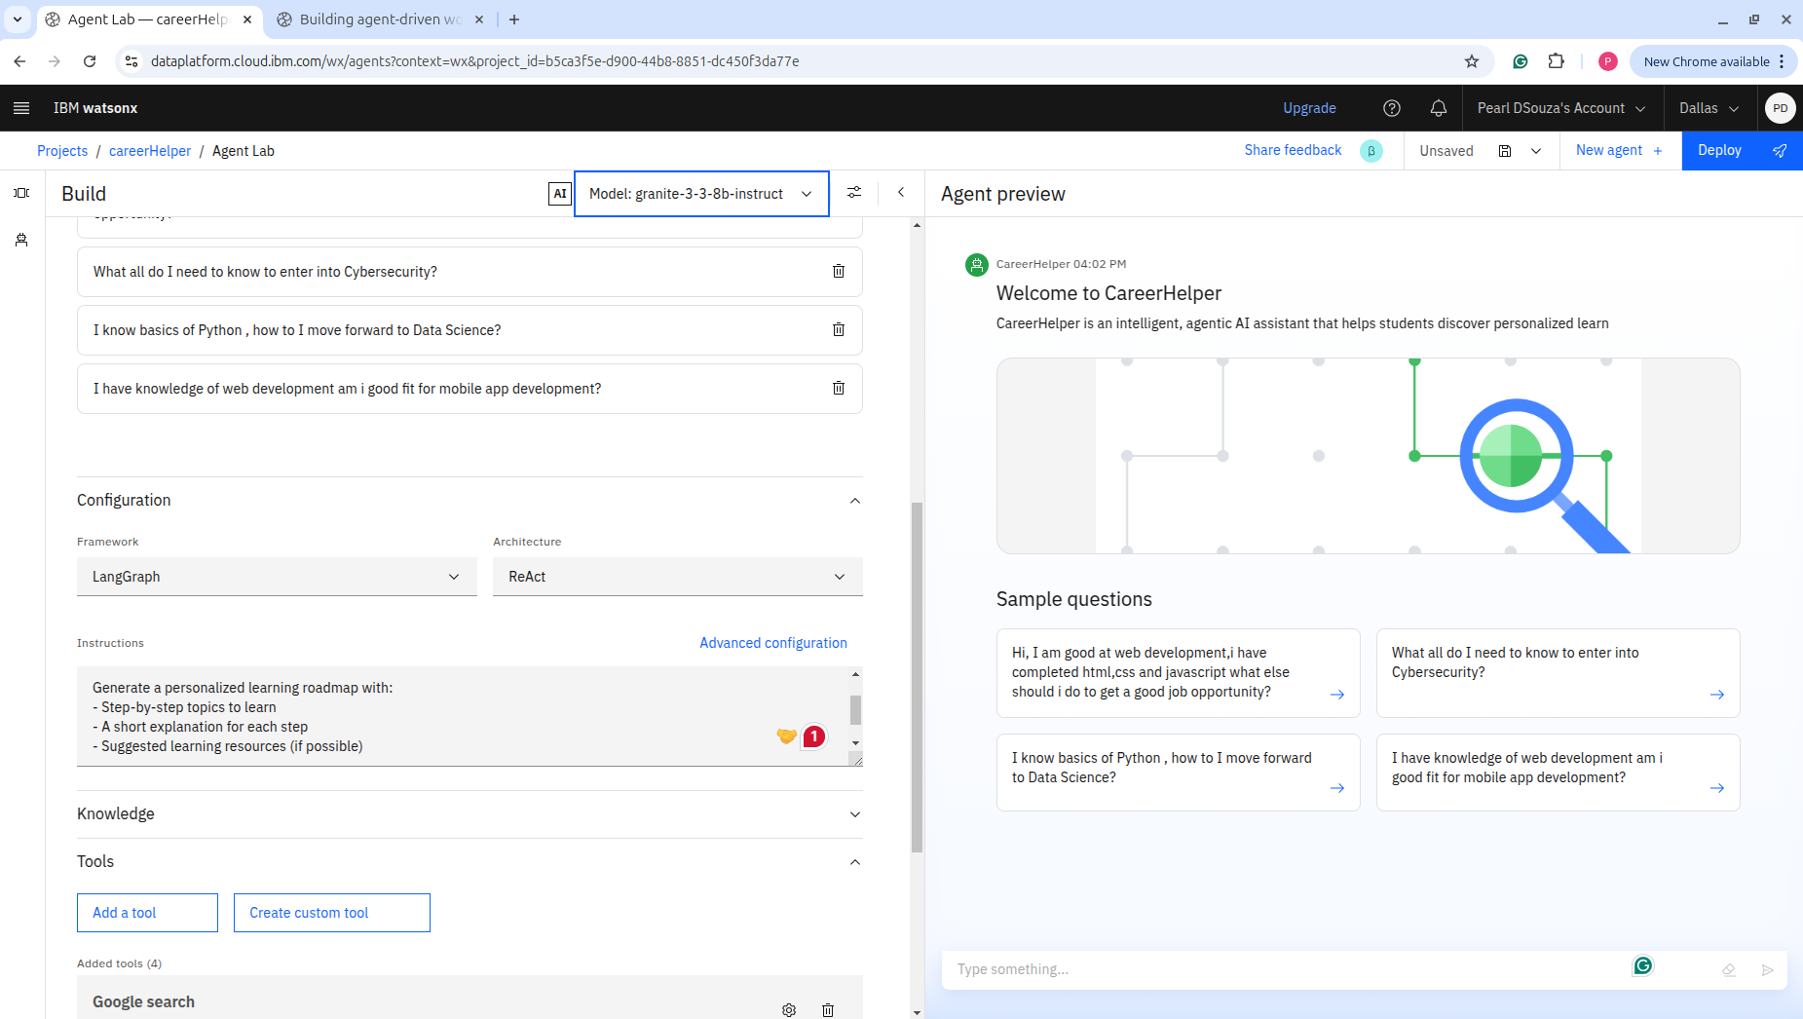
RESULTS

Slide 9
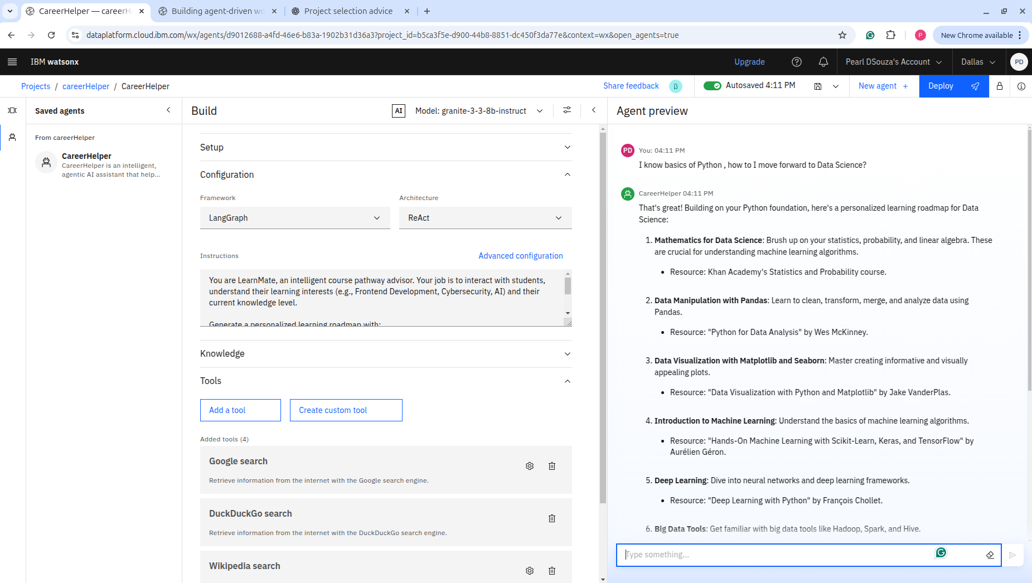
RESULTS

Slide 10
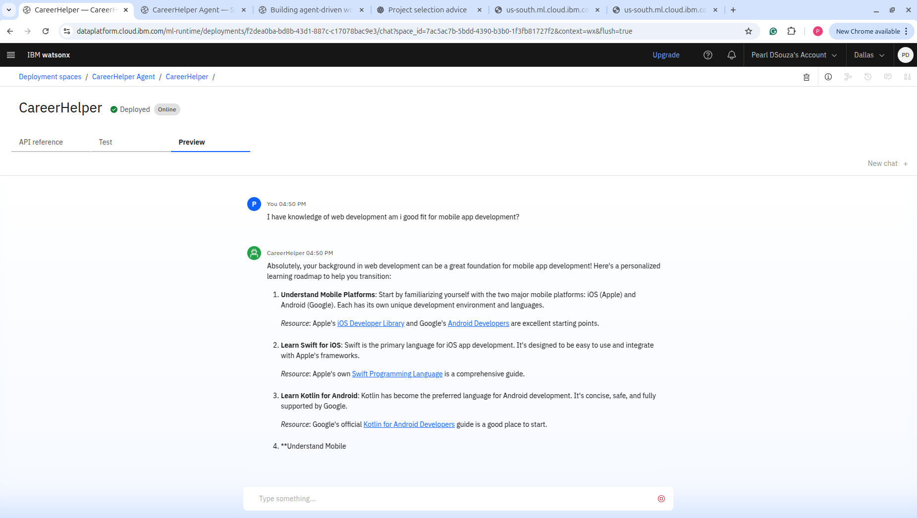
RESULTS

Slide 11
RESULTS
Deployed AI Agent

Slide 12
CONCLUSION
CareerHelper uses IBM Granite LLM on watsonx.ai to deliver personalized, step-by-step learning pathways based on user interests and skill levels.
It acts as a virtual mentor, helping learners make informed decisions, stay focused, and progress efficiently toward their goals.
The agent demonstrates how AI can make education more adaptive, accessible, and goal-oriented without manual intervention.

Slide 13
FUTURE SCOPE
Multilingual Support
Voice-Based Interaction
Progress Tracking & Adaptive Feedback
Career Goal-Based Roadmapping
Gamified Learning Path
Integration with Learning Platforms

Slide 14
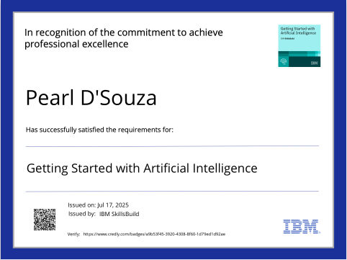
IBM CERTIFICATIONS

Slide 15
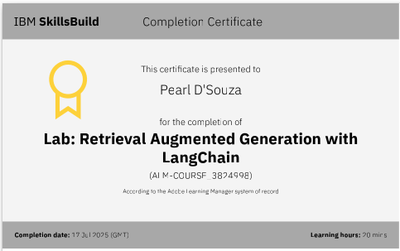

Slide 16
Git hub link : https://github.com/pearl148/IBMSkillbuildAIAgent

Slide 17
GITHUB LINK
Make sure that there should be readme file

Slide 18
THANK YOU

